Slide 1
Time Series Shapelets: A New Primitive for Data Mining
Lexiang Ye, Eamonn Keogh

Slide 2
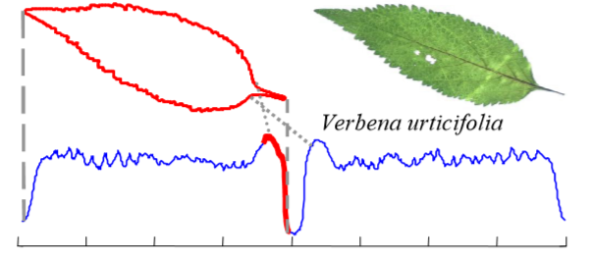
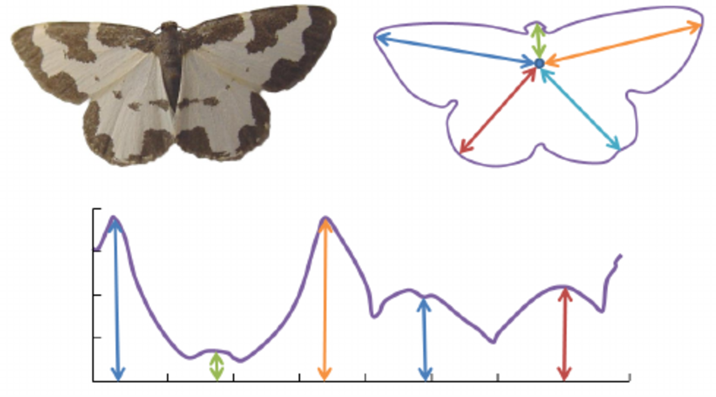
Timeseries
Way to convert each leaf into a one-dimensional representation
Angel - based
Euclidean distance

Slide 3
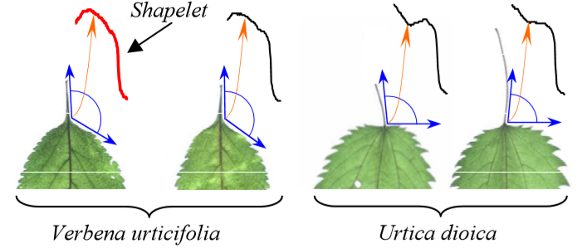
Shapelet
A subsection of the time series
Notes:
Shapelet là feature cần tìm

Slide 4
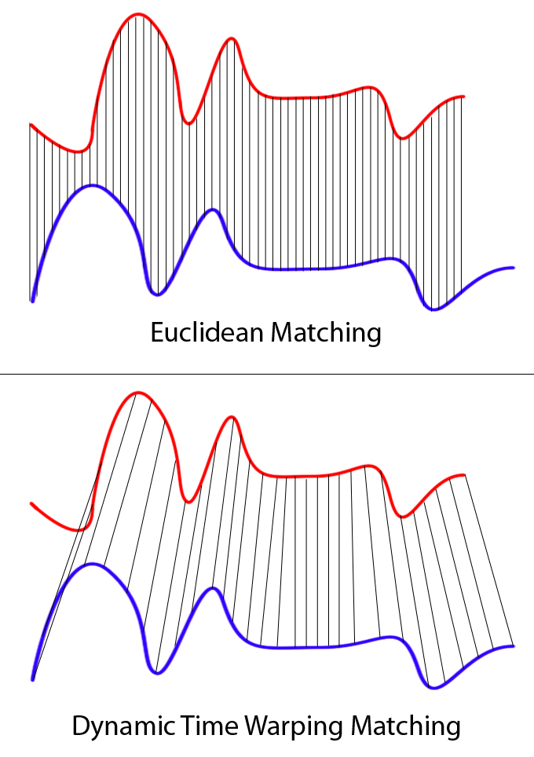
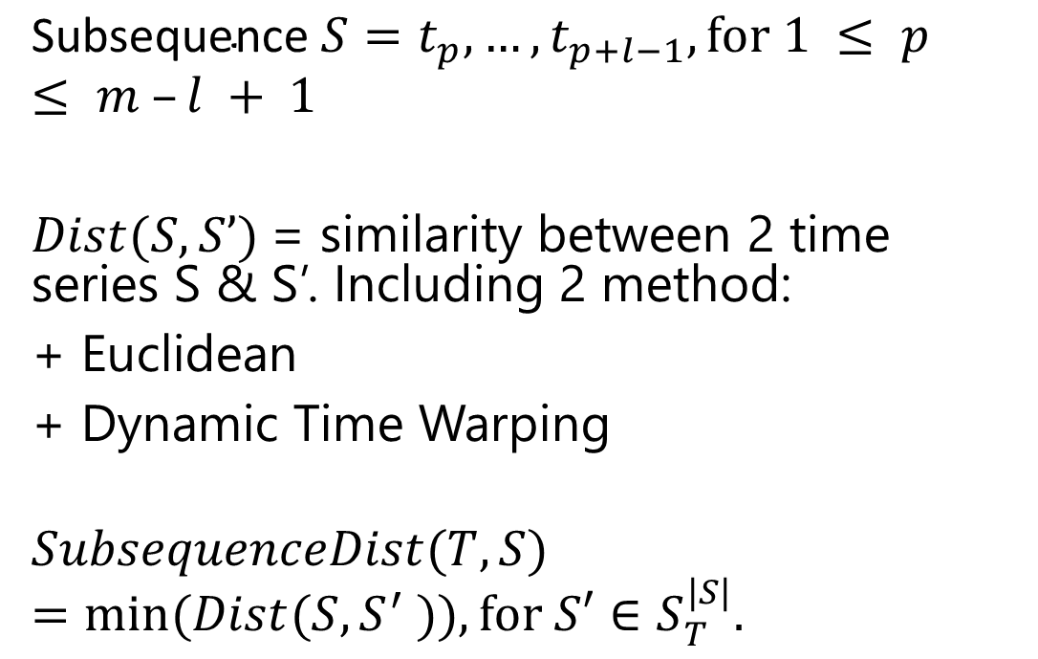
Subsequence & Distance
$$\text{Subsequence} S=t_{p},…,t_{p+l−1}, for 1 ≤ p ≤ m –l + 1$$
$Dist(S, S’)$= similarity between 2 time series S & S’. Including 2 method:
+ Euclidean
+ Dynamic Time Warping
$$SubsequenceDist(T, S)=min⁡(Dist(S, S^{′} )),for S′∈S_{T}^{|S|}.$$

Slide 5
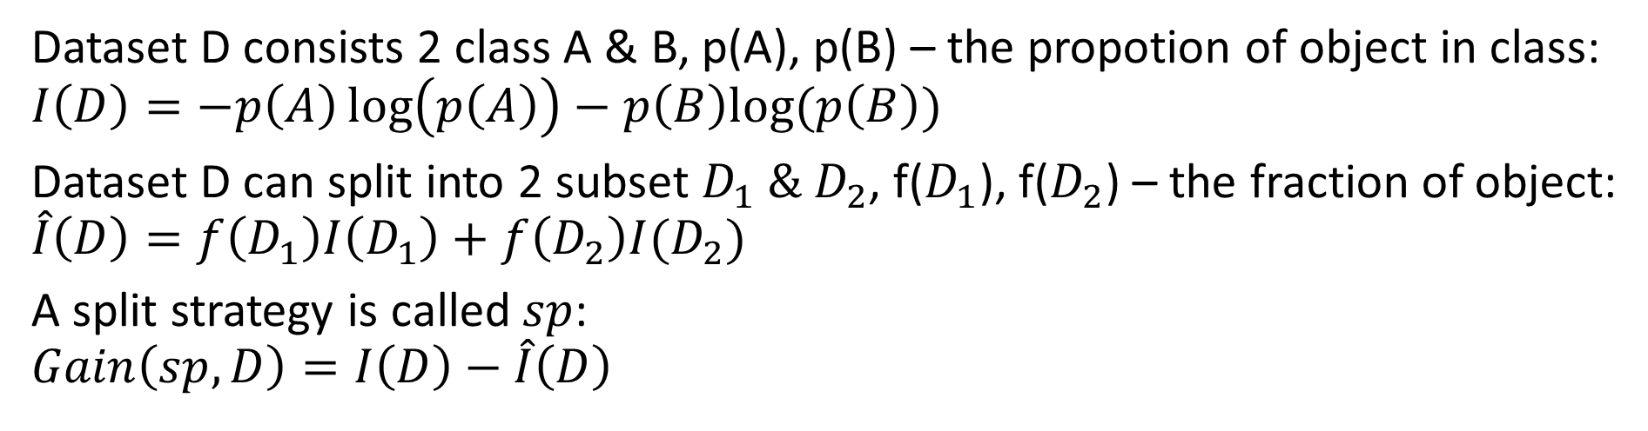
Gain Infomation
Dataset D consists 2 class A & B, p(A), p(B) – the propotion of object in class:
$$I\left(D\right)=−p\left(A\right)\log\left(p\left(A\right)\right)−p\left(B\right)log⁡(p\left(B\right))$$
Dataset D can split into 2 subset $D_{1} \& D_{2}$, f($D_{1}$), f($D_{2}$) – the fraction of object:
$$\hat{I}\left(D\right)=f\left(D_{1}\right)I\left(D_{1}\right)+f\left(D_{2}\right)I(D_{2})$$
A split strategy is called $sp$:
$$Gain\left(sp,D\right)=I\left(D\right)−\hat{I}\left(D\right)$$
$$=\left(−\frac{6}{10}\log\left(−\frac{6}{10}\right)−\frac{4}{10}\log\left(−\frac{4}{10}\right)\right)−\frac{5}{10}\left(\frac{5}{5}\log\left(\frac{5}{5}\right)\right)−\frac{5}{10}(−\frac{4}{5}\log\left(\frac{4}{5}\right)−\frac{1}{5}\log\left(\frac{1}{5}\right))$$
Notes:
Nhiễu

Slide 6
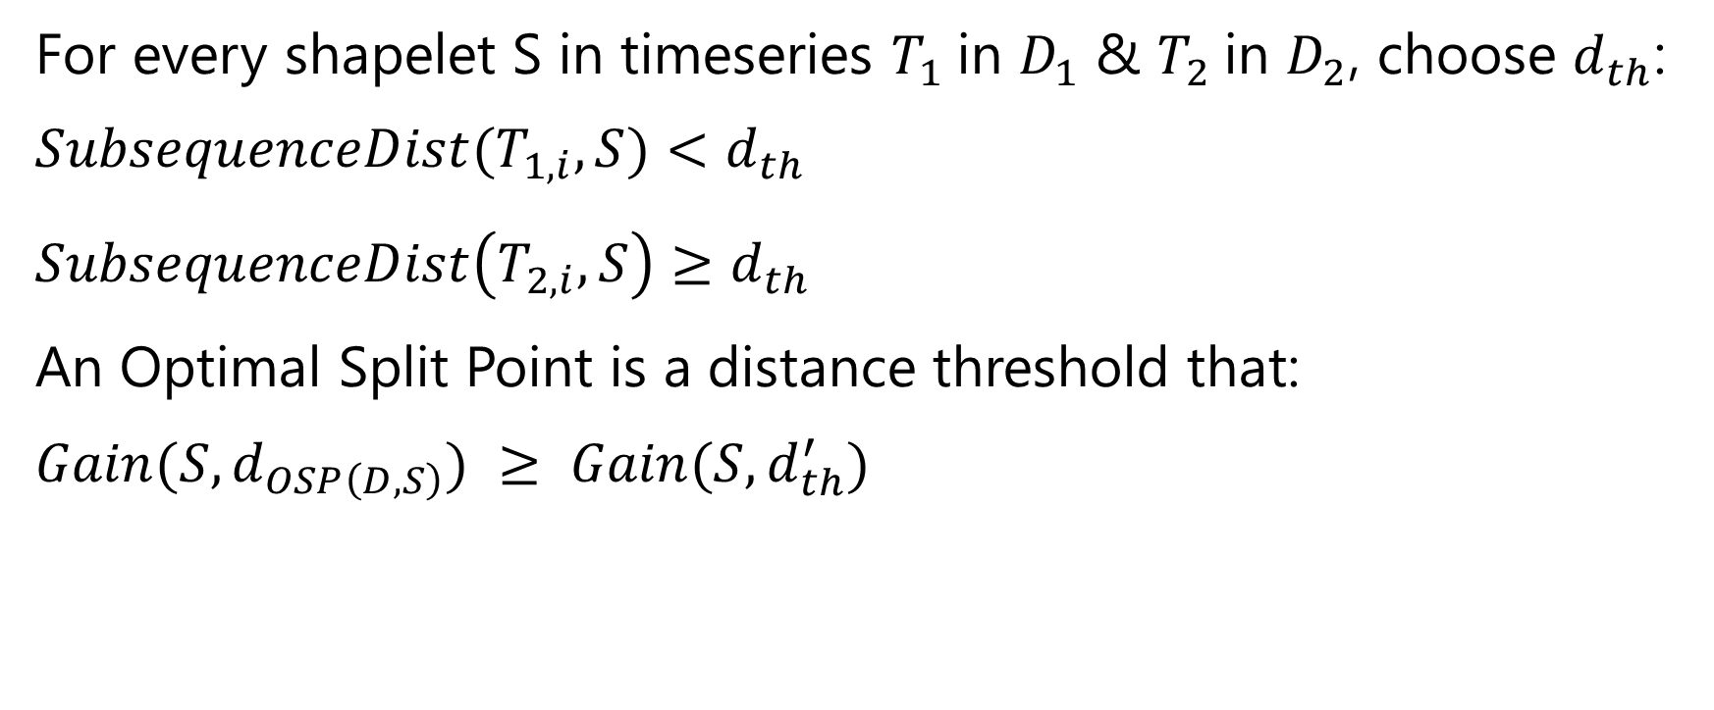
OSP – Optimal split point
For every shapelet S in timeseries $T_{1}$in $D_{1}$ & $T_{2}$in $D_{2}$, choose $d_{th}$:
$$SubsequenceDist(T_{1, i}, S)<d_{th}$$
$$SubsequenceDist\left(T_{2, i}, S\right)≥d_{th}$$
An Optimal Split Point is a distance threshold that:
$$Gain(S,d_{OSP\left(D, S\right)}) ≥ Gain(S, d_{th}^{′})$$

Slide 7

Shapelet
Subsequence Shapelet(D), with its correspond OSP:
$Gain(Shapelet(D),d_{OSP\left(D, S\right)}) ≥Gain(S,d_{OSP\left(D, S\right)})$ for any other subsequence S

Slide 8
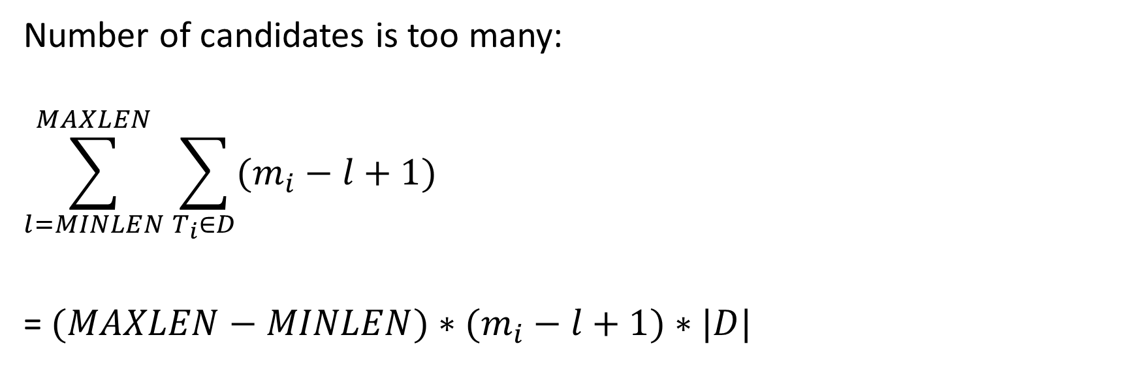
Problem
Number of candidates is too many:
$$\sum_{l=MINLEN}^{MAXLEN}{\sum_{T_{i}∈D}{(m_{i}−l+1)}}$$
= $(MAXLEN−MINLEN)∗(m_{i}−l+1)∗|D|$

Slide 9
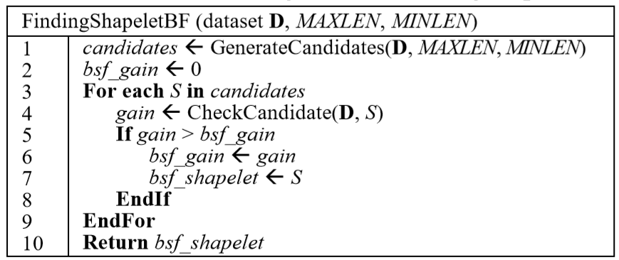
Finding Shaplet
Brute – Force Algorithm

Slide 10
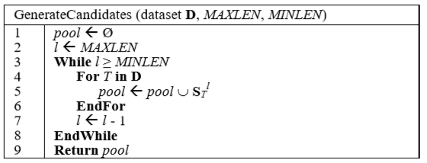
Finding Shaplet
Generate candidates

Slide 11
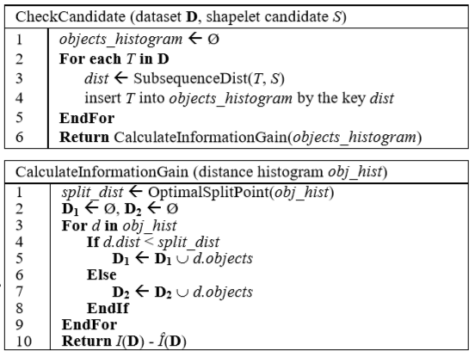
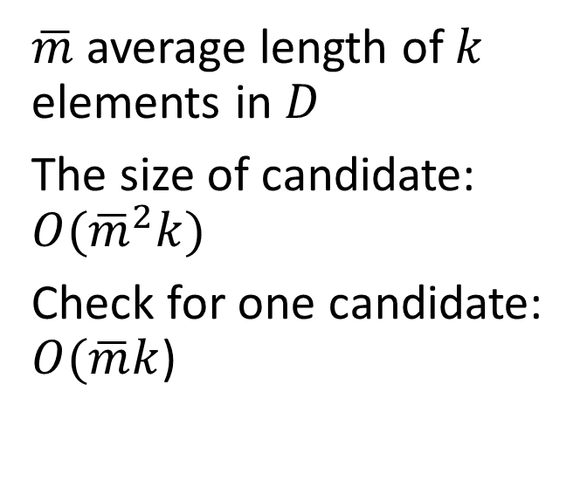
Finding Shaplet
Check candidates
$\overline{m}$ average length of $k$ elements in $D$
The size of candidate: $O({\overline{m}}^{2}k)$
Check for one candidate: $O(\overline{m}k$)

Slide 12
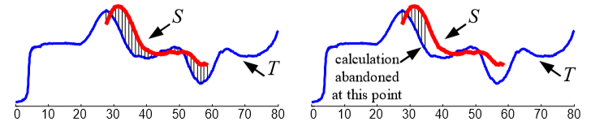
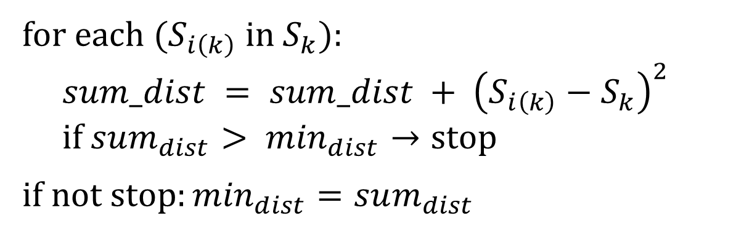
Resolving
Subsequence Distance Early Abandon
for each ($S_{i\left(k\right)}$ in $S_{k})$:
$$sum_dist = sum_dist + {\left(S_{i\left(k\right)}−S_{k}\right)}^{2}$$
$$if sum_{dist}> \min_{dist}→stop$$
$$if not stop:\min_{dist}=sum_{dist}$$

Slide 13
Resolving
Admissible Entropy Pruning
Assume that we calculated the first candidate and its corresponding Gain Information G

Slide 14

Resolving
For next candidate, we don’t need to calculate all distance, assume that all remaining cases are the best and recalculate gain.

Slide 15
My comments
Advantages:
Good method for shape features
Disadvantages:
Difference species may have the same shapelet
Notes:
Easy overloading if the problem provides too many classes
The calculation time increases slowly while the dataset size increases quickly

